Slide 1

FINGERPRINT STUDENT ATTENDANCE APP
GROUP 23
TASK 6 : Databse Design and Implementation

Slide 2
Table of Content
01
Introduction to Database Design
02
Database Technology Stack
03
Entity Relationship and ER Diagram
04
Relational Schema
05
Conclusion

Slide 3
Introduction
Database design is a crucial aspect of any application that manages data.
This mobile application allows users to input specific details such as course code, session time, and date to generate detailed attendance reports.

Slide 4
Importances of Database Design
Data Integrity and Accuracy
Performance Optimization
Scalability
Maintainability

Slide 5
Database Technology Stack
02

Slide 6

Firebase
Firestore

Slide 7
Ease of Use
Firestore integrates seamlessly with other Firebase services and provides an easy-to-use API for data operations.
HighCompatibility with React Native
Firebase is easily compatible with React Native in development
Security Rules
Firestore allows for fine-grained access control through security rules.
Scalability
Firestore can handle large volumes of data and high query loads
Real Time Data Synchronization
Changes to the data are instantly reflected in the app, providing real-time updates.

Slide 8
Entity Relationship Diagram
03

Slide 9
3.1 Entities
Admin Entity
Student Entity
Session Entity
Attendance Entity

Slide 10
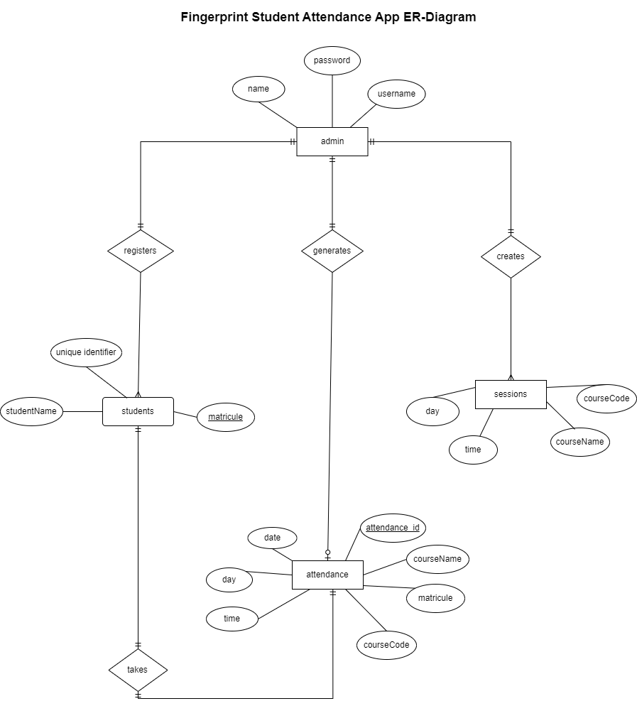

Slide 11
Relational Schema
04

Slide 12
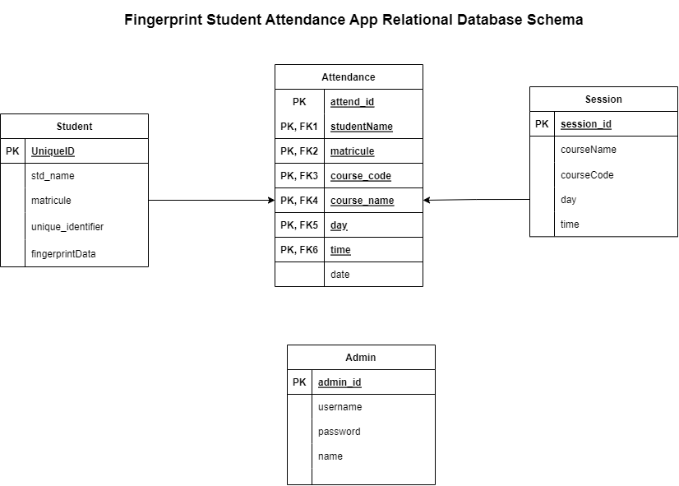

Slide 13
Schema on Cloud Firestore

Slide 14
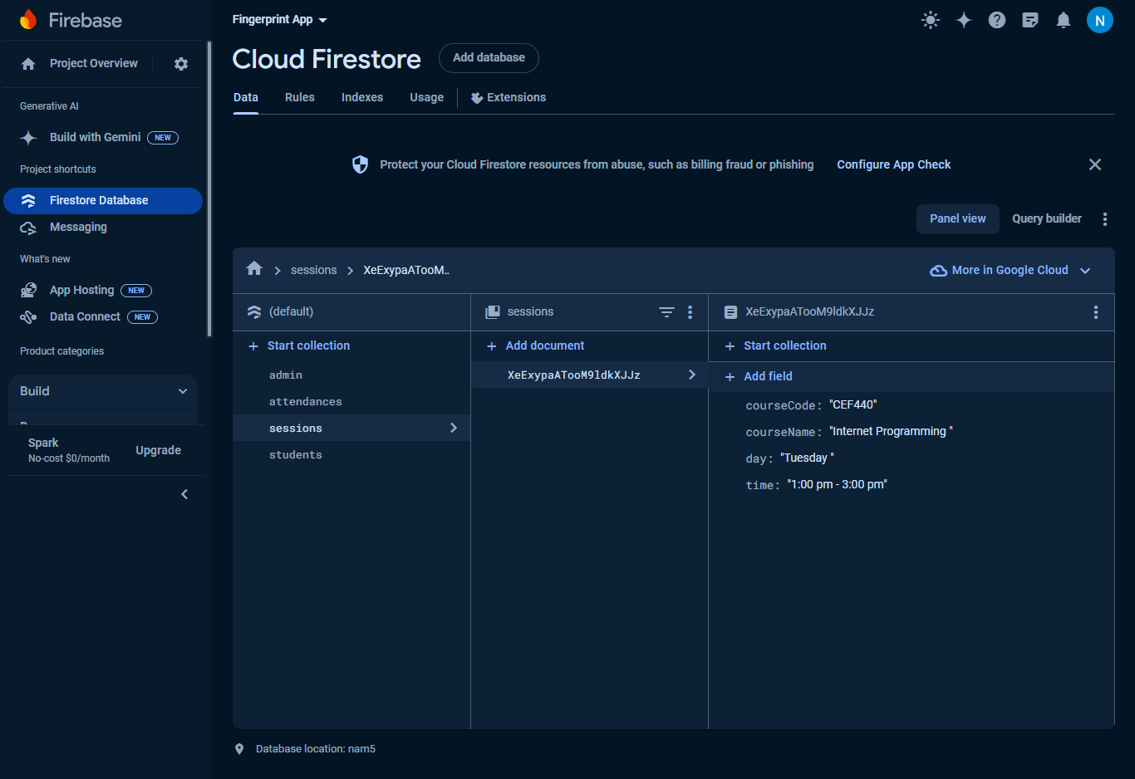

Slide 15
CONCLUSION
In summary, the database design for the Attendance Report Generator app is focused on creating a robust, efficient, and scalable system for managing attendance records.
By leveraging Firebase Firestore, the app benefits from real-time data synchronization, easy scalability, and secure data handling.

Slide 16
THANK YOU

